Slide 1
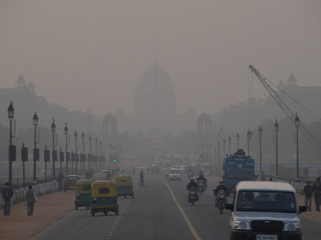
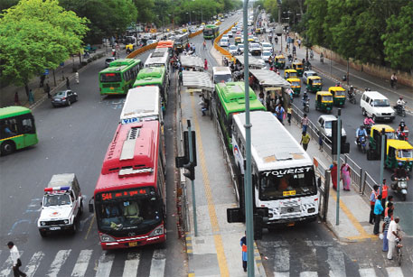
Understanding the Narratives and Framing of Air Pollution in Delhi, India
Kristin Olofsson & JC Martel
School of Public Affairs
University of Colorado, Denver
Notes:
Policy narratives
Media framing
1

Slide 2
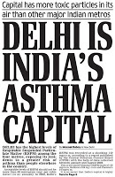
Research Question
How is the air pollution issue in Delhi being framed by mass media and nonprofit organizations?
Why study the issue of air pollution in Delhi?
Complex challenges
Urban sustainability
Policymakers’ priorities
Lend meaning to state action
Notes:
Our research logic
Delhi is one of the most polluted cities in the world with transportation as a leading cause of air pollution.
The government has enacted some mitigation policies to control air pollution.
Many policy actors, including environmentalists, academics, public health professionals, industry lobbies and the general public are engaged in Delhi’s air pollution policy issue.
The lessons from field work in India suggested we need mixed methods for tackling the research question.
Our physical distance from policy actors and processes
Language and cultural barriers
Limited access to documents
Limited access to a generalizable
sample of policy actors
Unexplored policy domain in the literature
Unreliable/absent publicly available data
Objective: Explore policy actors’ values and beliefs about air pollution
Goals: Present how policy actors are framing other actors, causes, effects and solutions for air pollution
Urban sustainability is a complex challenge, especially in developing countries that have infrastructure or administrative capacity concerns when meeting the needs of their rapidly growing populations. Policymakers face complex challenges of addressing climate change coupled with water scarcity, environmental concerns, public health needs, and demand for economic growth. In addressing these multiple and interdependent priorities, sustainability is often sacrificed for immediate gains. In deciding how to prioritize different sustainability goals, policymakers often respond to the opinion of the public and experts. Those opinions can be framed or depicted in the media and publicly consumable documents, which influence the public and policymakers’ opinions.
2

Slide 3
Complementary Methods
Mass Media: Inductive approach using automated text coding of news media coverage
AutoMap
Nonprofit Organizations: Deductive approach using narrative analysis that focuses on the stories told via online documents from nonprofit organizations
Narrative Policy Framework
NVIVO
Intercoder reliability
Notes:
Given the lessons that we learned in India, we developed the following research design.
Descriptive
Sample:
Mass Media: 235
Policy Narratives: 37
Intercoder Reliability at +90%
3

Slide 4
Mass Media

Slide 5
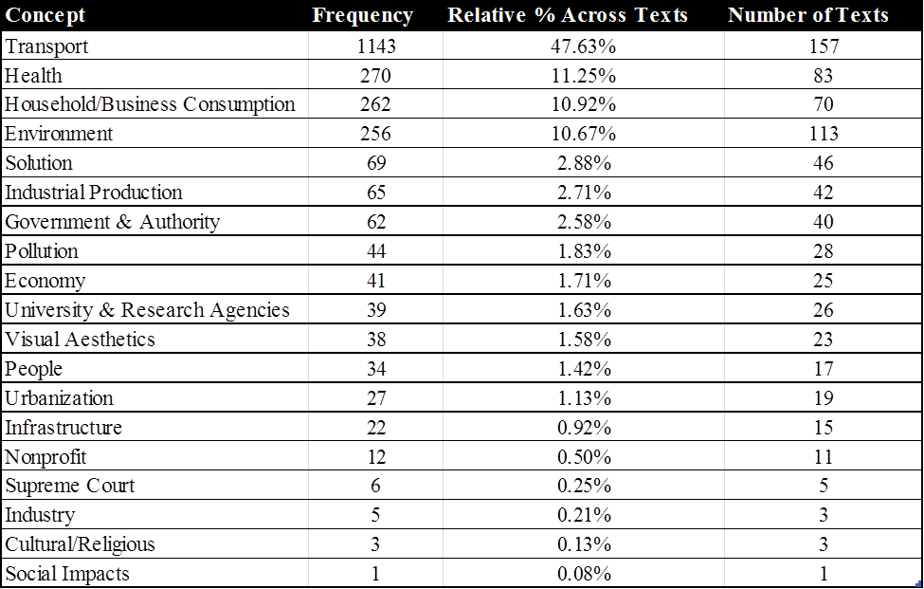
Concept Frequency Within Mass Media Sample
Notes:
Transport and Health
By developing parameters for the air pollution frame through the concepts, nuances such as solutions are brought forward. The Supreme Court, which has played a prominent role in implementation of the recent Bus Rapid Transit policy, is noted through the concept frequency but would have otherwise been lost in the analysis since its relative occurrence across all concepts is low.
5

Slide 6
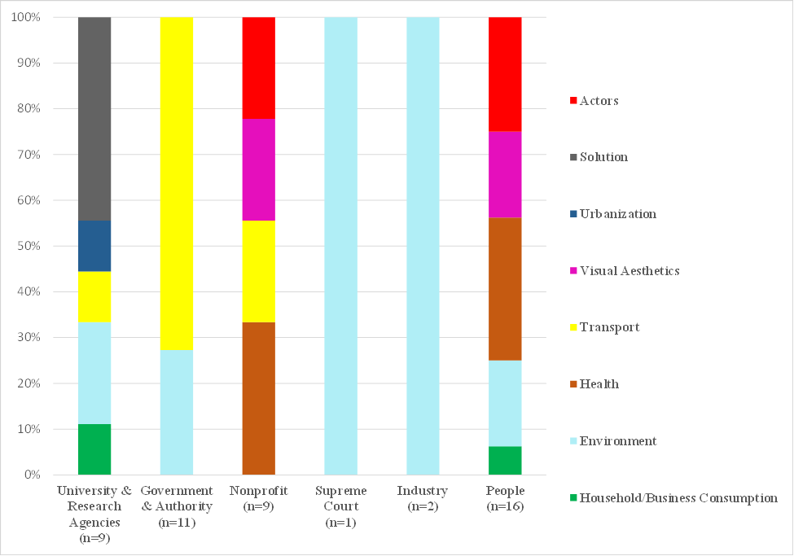
Relationships Between Actors and Concepts
Key Findings
Actors play different roles
Environment concepts co-occur most
University & Research frame more scientific
Solutions not associated with Government
Actor Type
Notes:
6

Slide 7
Nonprofit Organizations

Slide 8
Causes, Effects, and Solutions Portrayed
Notes:
Not surprising, but valid
Adds intent to the mass media findings
8

Slide 9
Types of Actors Portrayed
Key Findings
Government is both a Hero and a Villain
Supreme Court and University & Research Agencies are primarily Heroes
Wealthy People & Car Owners are only framed as Villains
Notes:
The documents framed actors as heroes, victims, and villains: heroes who seek to solve the problem, villains who exacerbate it, and victims who suffer.
Government and authority had the largest representation of the actor categories, divided across frames as heroes (54%) but also as villains (38%), which typically focused on their ability or inability to enact solutions for air pollution.
The Supreme Court was coded distinctly from the more general government and authority category and was framed as a hero in 22% and as a villain in only 3% of the documents. The nonprofits commonly praise the Supreme Court for passing environmental directives, such as Compressed Natural Gas (CNG) fuel use and Bus Rapid Transit (BRT) systems. Similarly, universities and research agencies are frequently framed as heroes (24%) for releasing studies that expose the air pollution issue; however, some studies are rejected by the environmental nonprofits when they do not align with their policy beliefs.
Wealthy people and car owners are framed as villains, as some narrators associate car owners with affluence, privilege, and selfishness, while poor people, vulnerable populations, transit users and pedestrians are framed as victims. This points to the value-laden aspect of the frames, whereby economic inequality and environmental justice issues underpin the frames. For example, the nonprofits exposed the issue of relocating industries to Delhi’s periphery, in areas occupied by poorer citizens, and that those who cannot afford cars, or even bus fare, are most at risk of air pollution.

Slide 10
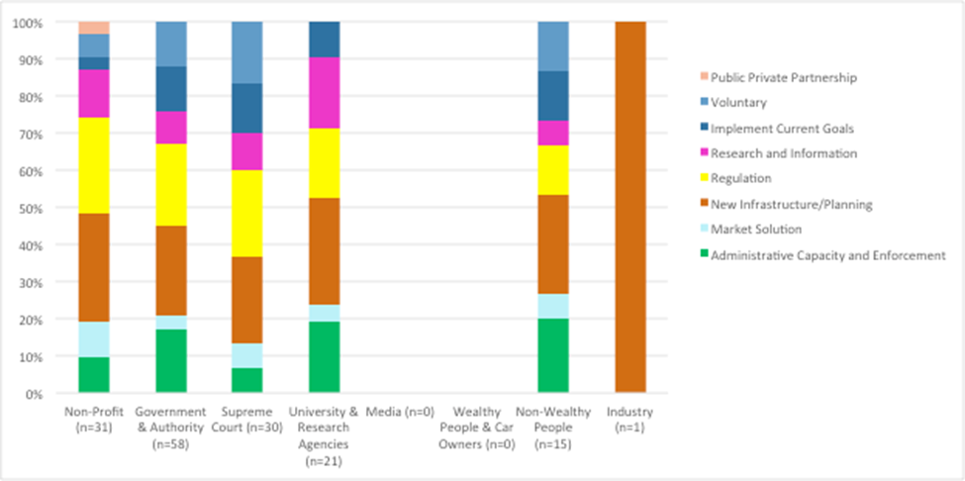
Actors in Relation to Solutions
Actor Type
Notes:
Causes, effects, and solutions for air pollution are often discussed in the context of characters. Actor types are expressed in relationship to the causes, effects, and solutions.
Nonprofits present a multitude of solutions, while Industry only presents one (New Infrastructure and Planning).
10

Slide 11
How is the air pollution issue in Delhi being framed by mass media and nonprofit organizations?
Mass Media |  | Nonprofit Organizations
Highest frequency concepts | TRANSPORTATION AND HEALTH | Most cited Cause & Effect, respectively
Frames without solution words | GOVERNMENT | Frames as both Hero and Villain
Frames University & Research Agencies with most solution words | SOLUTIONS | Solution: New Infrastructure & Planning correlates with most actor types
Highest co-occurrence with other categories | PEOPLE | Only Victim type framed
Notes:
Policy narratives become entrenched within issue domains and the resulting decision-making stabilizes around existing patterns of description. This is relevant to the reoccurring focus on transportation as the leading cause and health as the dominant effect of air pollution. This study sought to reveal the less articulated causes, effects, and solutions, as well as the interrelatedness between causes, effects, solutions, and characterization.
Mass media and other narratives continue to influence the frames of discourses, which bounds the arena for future climate adaptation and mitigation interventions. Failing to establish how an issue is being framed limits the potential for action by ignoring the existing communication strategies of the mass media and other policy actors.
Confirm popular perceptions – intuitive, but hasn’t been documented
Consistency between methods
Important nuances
Look at multiple sources of framing
What does this mean for policy? Policy narratives become entrenched within issue domains and the resulting decision-making stabilizes around existing patterns of description. Research informs a wide range of actors in Delhi’s air pollution policy subsystem. Each policy subsystem is unique in its institutional, political, social and economic context so additional studies would need to be conducted in different contexts to compare and contrast priorities and perceptions on air pollution.

Slide 12
Thank you!
Kristin Olofsson – Kristin.Olofsson@ucdenver.edu
JC Martel - JC.Martel@ucdenver.edu
Notes:
12

Slide 13
Future Research Plans
Increase NPF sample size using WebCrawler
Develop interview protocol for return trip to India
Analyze solutions in-depth
Compare Delhi, Beijing, Los Angeles
Notes:
13

