Slide 1
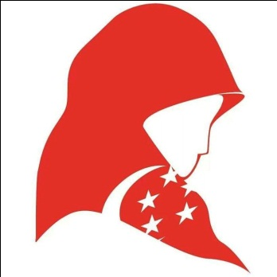
Re-examining Singapore’s ‘Multiculturalism’: A Case Study of the Hijab (Headscarf) Issue in Singapore
Humairah Zainal
Nanyang Technological University (NTU), Singapore

Slide 2
Research Questions
To examine the extent to which Singaporean Malay-Muslim women’s lived experiences are able to challenge prevailing stereotypes of the hijab in Singapore
To investigate the extent to which Singapore’s current notion of multiculturalism is still relevant in the context of increasing cosmopolitanism
To explore the ways in which Singapore can envisage the future of its peoples from diverse backgrounds

Slide 3
Theoretical Framework
The Singapore government has appropriated ‘race’ as a tool of governance
Racial complexity in Singapore is overrated
‘Multiracialism’ and ‘multiculturalism’ refer to two different terms
Institutionalization of identities under ‘multiracialism’ has foreclosed commitments to cultures other than ‘CMIO’
Hijab as an overlooked cultural marker of difference
A social psychological approach captures the complexity of people’s daily lived experience

Slide 4
Research Methodology
Interviews with Singaporean Malay-Muslim female undergraduates from NUS, NTU, SMU and UniSIM
Placing the focus on Malay-Muslim women reveals much-needed information about their daily lived experiences of the hijab
Acknowledges the need to correct any misconceptions of the hijab and re-examine its current policy
Secondary sources
Policy reports
Newspaper articles
Internet portals

Slide 5
Interview Findings (1): Non-Muslim Attitude Towards Muslims
Hypersensitivity and paternalism reflect deep entrenchment of racial and religious differences
Understanding of one another’s beliefs and practices remain superficial, inaccurate and antagonistic
Many non-Muslims remain ignorant as to why Muslim women have to don the hijab
Open discussions as opposed to closed-door dialogues

Slide 6
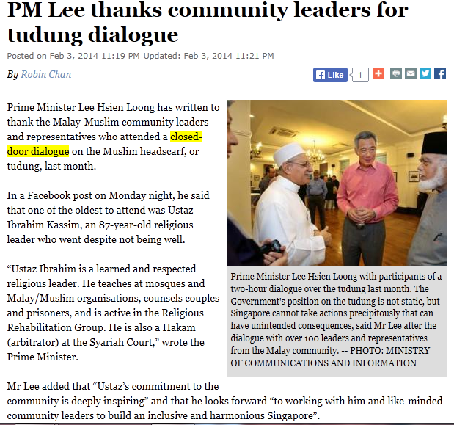
Source: The Straits Times, 3rd February 2014

Slide 7
Interview Findings (2): Muslim Perceptions of the Issue
Interviews challenge state’s rationalization that hijab serves as a hindrance to national integration
Hijab does not affect work productivity
Conflicts may also occur among people of the same race
Far from hindering national integration, the hijab in fact promotes cross-cultural interaction and understanding among various races

Slide 8
Interview Findings (3): Comparison with the Global Experience
Local media conflation of hijab with terrorism is inaccurate and irrational
Unlike American societies, the immediate form of cross-cultural contact that Singaporeans are exposed to is only with people from the ‘CMIO’ categories
Unlike Muslims in America who have enjoyed an elevation of socio-economic status, Muslims in Singapore are marginalized in terms of political security and social recognition by the state.
Unlike the increasing religiosity of American society, the state views religion as a moral ballast for Singaporeans

Slide 9
Envisaging the Future of Multiculturalism in Singapore
‘Multiculturalism’ in Singapore must be re-examined in the context of increasing cosmopolitanism of the city-state
Today’s ‘multiculturalism’ should incorporate cosmopolitanism
Cosmopolitanism must begin with a sustained engagement with the everyday life and contexts in the city
Cosmopolitanism has to consider local interaction with different groups of foreigners
Cosmopolitanism must show how foreigners can enrich Singapore’s social and cultural diversity in ways that will enable Singaporeans to learn to live with strangers, to enter into new experiences and interests, and to develop a richer and more complex sense of themselves.

Slide 10
Conclusion
Successful inter-ethnic policy needs to rest on a more in-depth understanding of how people construe and relate to multiculturalism in the context of their everyday lives.
Women’s positive experiences with the hijab have challenged prevailing stereotypes of it to a large extent
Current notion of multiculturalism needs to be broadened in view of the increasing cultural diversity of the city-state
Extensive research on the experience of Singaporean Muslim women working in ‘frontline’ jobs needs to be conducted

