Slide 1
Local Policies for Global Sustainability: Addressing the Impacts of Hydraulic Fracturing in Shale Gas Extraction Kris Hartley Lee Kuan Yew School of Public Policy 26 May, 2014

Slide 2
Outline
Key points
Technical background
Patterns of adoption
Environmental implications
Political contention
Detailed examples
United States
New Zealand
Asia
Conclusion

Slide 3
Main Ideas (1 of 7 topics)
Political context
Structure: multi-layered governance (fragmentation and polycentricity) to address borderless problem
Contention: imbalance in political influence (corporate lobbying vs. grassroots advocacy)
Policy substance
Rapid adoption of fracking motivated by
Quick profits (real)
Energy security (rhetorical)
Lower energy cost to consumer (rhetorical)
Uncertain environmental impacts
“Shoot now, ask questions later”
Use of evidence
Credibility of competing sources

Slide 4
Technical Background (2/7)
Increases (US) reserves significantly: oil by 30% and gas by 90% (Montgomery and Smith 2010)
Of domestic natural gas reserves, shale formations accounted for 2% in 2001; in 2012, shale accounts for 25% (Trembath et al. 2012)
Shale is projected to account for 49% of all natural gas production in the US by 2025 (Fry, et al. 2012)

Slide 5
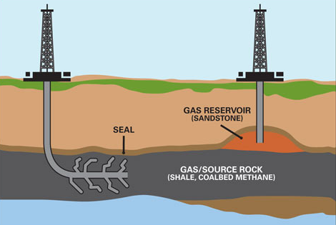
Technical Background (2/7)
Source: http://www.environmental-watch.com/wp-content/uploads/2013/01/hydraulic-fracking.jpg

Slide 6
Patterns of Adoption (3/7)
85% of fracking equipment and activity is in North America
Differences in uptake between the US and other countries:
Equipment and technical sophistication
Costs (up to four times higher outside the US; Beckwith 2010)
Quality of and access to data for improving production yields
China and India have better capacity for data analysis through agreements (and joint ventures) with US companies
Countries with the largest reserves (Russia, Iran, and Qatar) combine for nearly 15-times the reserves of the US
Land with significant shale deposits is also being leased or purchased in Central and Eastern Europe

Slide 7
Environmental Impact: Concerns (4/7)
Water contamination
Chemical composition and the threat of surface and subterranean leakage
48 cases of suspected water contamination in 206 chemical spills (Colorado 2008)
Airshed contamination
Air emissions from fracking include dust, diesel fumes, fine particulates, and methane
Volatile organic compounds (VOCs) in resurfaced chemicals during on-site compression process; contained and shipped, while others evaporate or burn off
Surface contamination
Flow-back from fracking fluid and additives can migrate to the surface
Liquid waste (drilling agents for pressurized injection); solid waste (drill cuttings)
Other concerns
Forest clearance, runoff, erosion, noise, odors, unsightliness, earthquakes
Blowouts (Ohio: a blowout led to surface gas “bubbling” and evacuation of 50 families)
Solutions: “green” additives, flow-back water recycling

Slide 8
Environmental Impact: Information (4/7)
Few studies link fracking with specific health impacts
Lack of conclusive data (Cooley and Donnelly 2012)
Some industry leaders insist that the impact of fracking on groundwater contamination is overstated (too deep to be a material threat)
A US Environmental Protection Agency (EPA) study found a link between groundwater contamination and fracking
US 2005 Energy Policy Act exempts companies from releasing information about fracking chemicals
Scientists and other researchers have been able to identify elements used in fracking

Slide 9
Political Contention (5/7)
Bulgaria
Government granted Chevron permission to prospect fracking (2011)
Weeks of protests and environmental campaigns followed
In January 2012, the Parliament banned fracking
Several months later, the government eased restrictions to allow for exploration of conventional natural gas
Other national-level responses
France has banned fracking
South Africa has imposed a moratorium
Switzerland has suspended permits for fracking (Negro 2012)
Regional moratoria
Victoria, Australia (2012)
New South Wales (2011); partially in response to community opposition
Are bans/moratoria a result of evidence or political pressure?
Political pressure from citizen activism mobilized by evidence

Slide 10
Political Contention (5/7)
Anti-fracking protests: Colorado (Sirota 2012), Romania (Trefis 2012), North Carolina (AFL-CIO 2012), and Quebec (Fidler 2012)
September 22 designated Global Anti-Fracking Day by a loose network (marches on South African Parliament and European Parliament in Brussels)
Kingdon’s (1984) multiple streams framework
Emergence of evidence (“problem stream”)
Grassroots action (“politics stream”)
“Policy stream” least likely to develop due to overlapping jurisdictions
Absence of instrument linking streams (more diagnostic than prescriptive?)
Sabatier and Jenkins-Smith’s advocacy coalition framework (1999)
Beliefs are the binding mechanism and impetus for coalition formation
Explains how evidence can influence changes in belief patterns
Lack of clear evidence is an obstacle to both anti-fracking policy advocacy and changes in beliefs

Slide 11
Example: United States (6/7)
Two dimensions in which evidence informs the policymaking process:
Scale: level, breadth of regulatory authority in multi-layered, fragmented systems
Influence: ability to elevate agenda; judicious venue shopping (Baumgartner & Jones 91)
US Energy Policy Act of 2005 dissolved EPA’s regulatory authority over fracking and chemical disclosure (Cheney; “Halliburton Loophole”)
The Safe Drinking Water Act is now the only apparatus to address fracking at the national level, along with species acts, OSHA, etc.
Environmental impacts (e.g. air pollution and waste management) are often legislated at the state/local level
Sub-national policy initiatives
New Jersey and New York have imposed moratoria on fracking
New York City and Syracuse have limited or outlawed fracking within watersheds
In Marcellus Shale region, some localities have banned the practice
2013 restriction by Dallas (Texas) within 1,500 feet of homes, schools, and churches

Slide 12
Example: United States lessons (6/7)
Mismatch between scale of governance and impact at issue
V. Ostrom (1972): linking scope of authority to scale of problem
US ideal of “home rule” and “states’ rights” → localization of policies
Impacts do not heed political boundaries (runoff, climate change, etc.)
Benefit: divide and conquer approach for activists
Evidence and politicization
Emotion and sensationalism (does it discredit agendas?)
Underlying socio-political debate about corporate influence
“Profiteering”
Circumvention of democratic system
Lack of regard for impacts on society, environment
Like the climate debate, each side uses evidence, reducing the substance of the debate to comparisons of evidence credibility
Political rhetoric about caution, but not outright prohibition

Slide 13
Example: New Zealand (6/7)
Like the US, NZ is federalized, fragmented in regulating fracking
Fracking regulated by 1991 Resource Management Act
Grants regional councils regulatory control over water and air discharges
Grants district councils control over related land use
Hazardous Substances and New Organisms Act (1996) regulates fracking chemicals (handling, storage, use, spill contingencies)
Resource consenting under regional councils, raising concerns:
Expertise (do councils have capacity to understand fracking in their areas?)
Coordination (regulation among neighboring jurisdictions)
Five local authorities (Dunedin Council) imposed moratoria
No moratorium at the national level seriously discussed despite calls by the NZ Green Party and NZ Greenpeace
Advocacy targets the national level (due to NZ’s small size?)

Slide 14
Asia (6/7)
Fracking may become more common, especially in Asia
Volatility of global energy prices; aim for national self-sufficiency
Availability of cost-effective fracking technologies
China
Plans 1,400 fracking wells by 2015, but lacks related regulations about groundwater quality and other contamination hazards
Many shale gas deposits are further underground than those in the US → additional technologies and unforeseen impacts
In early 2014, an explosion at a Jiaoshizen fracking well compelled Sinopec and town leaders to impose a “gag” order
India
Fracking slower to develop than in China
Staged reform process permitting shale gas exploration
Initially by state-owned energy companies
Ultimately by private investors

Slide 15
Asia (6/7)
Emerged mostly in fully developed democratic systems, giving opposition interests varying policy access
Inability of fracking opponents to precipitate policy change may be a failure of political capture rather than system design
Jiaoshizen event may be an indication of how fracking is approached in countries without “pluralist” democratic systems
In such systems, lack of information and evidence is a comparatively greater challenge to interest advocacy and informed policymaking
In pluralist democracies (India), threats to policy development may not be information scarcity or citizen marginalization, but political stalemate
The issue is governance structure, not evidence
This does not diminish the role of evidence, but concerns the nature of the political system, which may generate inequitable outcomes

Slide 16
Conclusion (7/7)
Universally applicable regulatory framework
Based on robust scientific evidence
Specific enough to capture all risk contingencies
Broad enough to be implemented across varying types of governance structures at local, subnational, and national levels
National legislation may be necessary
Overcome the analytical capacity limitations of local governments
Avoid corporate capture of policy that institutionalizes resistance to regulation (divide and conquer works for companies as well)
Minimize the power of political self-interest to countervail the collective efforts of victimized citizens
Few templates for drafting regulation amidst such complexity
The International Energy Agency (IEA 2012) has produced a series of “golden rules” for fracking

Slide 17
Conclusion (7/7)
Liberalization → opening of resource markets and fracking opportunities
Accompanied by democratization, liberalization can increase information flow and citizen empowerment (evidence as advocacy support)
These “opposable” forces (liberalization and democratization) must be reconciled in drafting legislation
The debate has raised broader concerns about social justice, economic equality, and political representation
Guiding principles should include
Observance of due caution until scientific understanding evolves
Full disclosure to the media and the public
Transparency when engaging corporate interests
Robust solicitation of citizen input
Is it possible to produce an evidence-based policy development model applicable to the unique system of every country likely to adopt fracking?
Such research transcends technicalities to address agenda setting, policy formulation, and particular decision making styles in each context

Slide 18
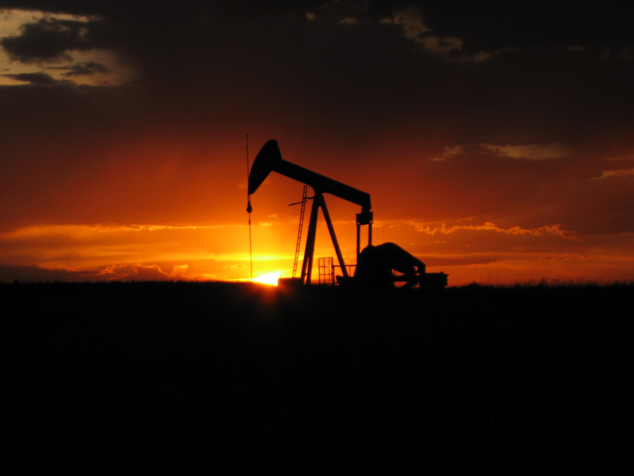
“ Thank you”
Kris Hartley hartley@nus.edu.sg www.krishartley.com

