Slide 1
Why Can’t We? Providing Ability and Motivation Practices to Public Sector Employees to Innovate
Mehmet Akif Demircioglu
mdemirci@indiana.edu

Slide 2
Methodology
Research Questions
Do potential enablers of innovation (ability to experiment, ability to dealing low performance, existence of feedback loops, existence of incentives for service improvement; existence of budget constraints) affect innovation?
Which tool/potential enabler is more effective
What about scope/density regarding innovation?
Quantitative
Logit models for binary dependent variable (innovation)
OLS, Poisson, and Negative Binomial for number of innovation
Data
Australian Public Service Commission (APSC)’s 2012 State of the Service Employee Census. A total of 87,214 valid responses were received, representing a response rate of 55%.

Slide 3
Outline
Theoretical Framework
Results
Discussion

Slide 4
Why Innovation-Motivation of Study
Innovation for survival (i.e. adapting the environment), global competition, flourish, effectiveness, efficiency, creating public value, improve governance.
Drivers of Innovation, i.e. financial, technological
Antecedents of innovation in private sector → many studies, including meta-analysis. But public sector innovation still promising topic. What factors (potential enablers) effect innovation?

Slide 5
Definition of Innovation
Schumpeter: “invention is the bringing into being of something new, whereas innovation is bringing something into use that has not been used before.”
Borrins: innovations “include both new programs and new ways of accomplishing existing program goals (2000, 47).”
Australia considers innovation both establish and adopt new ideas and practices for improving public sector efficiency, process, and outcomes (Fernandez & Pitts 2011).

Slide 6
Theoretical Framework
Sahni et al.’s framework → most of the following conditions should be present for innovation: Ability to experiment; ability to sunset outdated infrastructure; existence of feedback loops; existence of incentives for product or service improvement; existence of budget constraints for end users.
This paper tests, (a) how do these five potential enablers affect employees’ innovation, (b) which type of enablers are more effective in terms of innovation, (c) and regarding the scope and density, which enablers are associated with innovation?
Sahni, Nikhil R., Maxwell Wessel, and Clayton M. Christensen. 2013. Unleashing Breakthrough Innovation in Government. Stanford Social Innovation Review Summer: 27-31.

Slide 7
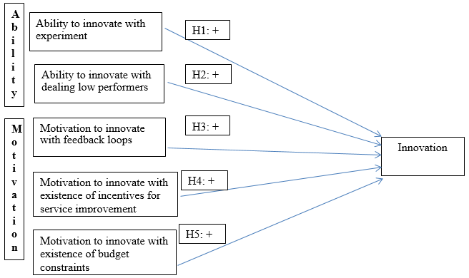
Theoretical Framework

Slide 8
Econometric Models
Model 1: Innovation = f(practice 1 [experiment], practice 2 [dealing low performers], practice 3 [feedback], practice 4 [incentives], practice 5 [budget constraints], agency size, gender, location, job level classification, length of service, education, working full-time vs. part-time).
Model 2: Innovation = f(practice A [ability], practice B [motivation], agency size, gender, location, job level classification, length of service, education, working full-time vs. part-time)
Model 3: Innovation = f(Enablers, agency size, gender, location, job level classification, length of service, education, working full-time vs. part-time)
Model 4: Same as model 1 with adding agency types
Model 5: Same as model 1 with adding type of job
Model 6: Same as model 1 with adding both agency types and type of jobs.

Slide 9
Descriptive Statistics
Variables | Mean | StdDev | Minimum | Maximum
Implementing innovation | 0.52 | 0.5 | 0 | 1
Practice 1 (Ability to experiment) | 3.48 | 0.94 | 1 | 5
Practice 2 (Dealing with low performers) | 2.96 | 0.85 | 1 | 5
Practice 3 (Existence of feedback loops) | 3.51 | 0.93 | 1 | 5
Practice 4 (Existence of incentives | 3.24 | 0.77 | 1 | 5
Practice 5 (Existence of budget constraints) | 2.84 | 1.07 | 1 | 5
Size of Agency | 2.85 | 0.43 | 1 | 3
Gender is female | 0.52 | 0.5 | 0 | 1
Working in the capital city | 0.37 | 0.48 | 0 | 1
Level of job classification | 1.41 | 0.49 | 1 | 2
Education Level | 2.24 | 0.84 | 1 | 3
Working full-time | 0.87 | 0.34 | 0 | 1

Slide 10
Data and Methods
Data come from Australian Public Service Commission (APSC)’s 2012 State of the Service Employee Census. A total of 87,214 valid responses were received, representing a response rate of 55%.
n=21,703 responses have been used.
Dependent Variable: “In the last 12 months, has your work group implemented any innovations?” (1=Yes [52%], 0=No [48%])
Summated Scales for Independent Variables (see extra parts)

Slide 11
Results (n=21073)
Standardized Coefficients | Model 1 | Model 2 | Model 3 | Model 4 | Model 5 | Model 6
Practice 1 (Ability to experiment) | 0.192*** |  |  | 0.187*** | 0.210*** | 0.208***
Practice 2 (Dealing with low performers) | -0.025 |  |  | -0.034 | -0.039 | -0.045
Practice 3 (Existence of feedback loops) | 0.111** |  |  | 0.122** | 0.121** | 0.127***
Practice 4 (Existence of incentives | 0.729*** |  |  | 0.733*** | 0.722*** | 0.726***
Practice 5 (Existence of budget constraints) | -0.026 |  |  | -0.025 | -0.012 | -0.012
Size of Agency | -0.034 | -0.050+ | -0.048+ | 0.087+ | -0.042 | 0.080+
Gender is female | -0.168*** | -0.144*** | -0.134*** | -0.146*** | -0.202*** | -0.191***
Working in the capital city | -0.173*** | -0.174*** | -0.174*** | -0.076* | -0.137*** | -0.060+
Level of job classification | 0.366*** | 0.399*** | 0.398*** | 0.402*** | 0.373*** | 0.392***
Education Level | 0.114*** | 0.116*** | 0.112*** | 0.129*** | 0.160*** | 0.168***
Working full-time | 0.129*** | 0.138*** | 0.137*** | 0.127*** | 0.129*** | 0.130***
Aability (practice 1 + practice 2) |  | 0.135***
Bmotivation (practice 3 + pract 4 + pract 5) |  | 0.709***
ENABLERS (all practices) |  |  | 0.797***
ll_0 | -15022.7 | -15022.7 | -15022.7 | -15022.7 | -15022.7 | -15022.7
Ll | -14390.6 | -14451.7 | -14458.2 | -14338.1 | -14260.1 | -14224.9
chi2 | 1264.3 | 1142 | 1129 | 1369.3 | 1525.2 | 1595.7
P | 2.22E-264 | 3.33E-241 | 1.55E-239 | 6.64E-283 | 6.69E-307 | 2.08e-318
df_m | 11 | 8 | 7 | 15 | 25 | 29
Aic | 28805.1 | 28921.5 | 28932.4 | 28708.1 | 28572.2 | 28509.7
Bic | 28900.9 | 28993.3 | 28996.2 | 28835.9 | 28779.8 | 28749.3
r2_p | 0.0421 | 0.038 | 0.0376 | 0.0456 | 0.0508 | 0.0531

Slide 12
Odds Ratio
Odds Ratio | Model 1 | Model 2 | Model 3 | Model 4 | Model 5 | Model 6
Practice 1 (Ability to experiment) | 1.107*** |  |  | 1.104*** | 1.117*** | 1.116***
Practice 2 (Dealing with low performers) | 0.985 |  |  | 0.98 | 0.977 | 0.974
Practice 3 (Existence of feedback loops) | 1.061** |  |  | 1.067** | 1.067** | 1.070***
Practice 4 (Existence of incentives | 1.601*** |  |  | 1.605*** | 1.594*** | 1.598***
Practice 5 (Existence of budget constraints) | 0.988 |  |  | 0.988 | 0.994 | 0.994
Size of Agency | 0.961 | 0.943+ | 0.946+ | 1.105+ | 0.953 | 1.097+
Gender is female | 0.846*** | 0.866*** | 0.875*** | 0.864*** | 0.817*** | 0.826***
Working in the capital city | 0.836*** | 0.836*** | 0.835*** | 0.925* | 0.868*** | 0.940+
Level of job classification | 1.450*** | 1.498*** | 1.498*** | 1.504*** | 1.460*** | 1.488***
Education Level | 1.070*** | 1.071*** | 1.068*** | 1.079*** | 1.099*** | 1.104***
Working full-time | 1.211*** | 1.227*** | 1.225*** | 1.206*** | 1.210*** | 1.212***
Aability |  | 1.033***
Bmotivation |  | 1.077***
ENABLERS |  |  | 1.065***

Slide 13
Density/Magnitude of Innovation
# of Innovation | Freq. Percent Cum.
------------+-----------------------------------
0 | 10,409 47.96 47.96
1 | 4,280 19.72 67.68
2 | 2,533 11.67 79.35
3 | 2,233 10.29 89.64
4 | 1,222 5.63 95.27
5 | 602 2.77 98.05
6 | 401 1.85 99.89
7 | 23 0.11 100.00
------------+-----------------------------------
Total | 21,703 100.00

Slide 14
Number of Innovation | Model 1: Linear Regression | Model 2: Poisson | Model 3: Negative Binomial
Practice 1 (Ability to experiment) | 0.059*** | 0.053*** | 0.054***
Practice 2 (Dealing with low performers) | -0.014 | -0.012 | -0.012
Practice 3 (Existence of feedback loops) | 0.032* | 0.029** | 0.032*
Practice 4 (Existence of incentives | 0.271*** | 0.229*** | 0.221***
Practice 5 (Existence of budget constraints) | 0.014 | 0.010+ | 0.011
Size of Agency | 0.069+ | 0.058* | 0.053
Gender is female | -0.088*** | -0.071*** | -0.075***
Working in the capital city | 0.03 | 0.024 | 0.018
Level of job classification | 0.225*** | 0.175*** | 0.173***
Education Level | 0.049*** | 0.041*** | 0.041***
Working full-time | 0.179*** | 0.159*** | 0.160***
Aic | 79644.096 | 71089.307 | 65485.999
Bic | 79883.653 | 71328.863 | 65733.54

Slide 15
Discussion
Practice 1 (ability to experiment), practice 3 (existence of feedback loops), and practice 4 (existence of incentives for product or service improvement) are positively correlated to public sector employees’ innovation. Practice 2 (dealing with low performers) and practice 5 (existence of budget constraints) do not have any effect on public sector employees’ innovation.
Practice 3 has the highest effect on employees’ innovation, suggesting that providing employees incentives for product or service improvement are the most effective tool that policy makers and senior bureaucrats can do.
External enforcements such as punishing low performers do not effect innovation. Intrinsic rewards such as creating a workplace which encourages innovation and employees own choices to decide how they would like to their work positively affect innovation.
Thus, self-determination theory (SDT), which states individuals’ behavior should be self-motivated and self-determined, is consistent with the paper’s findings. [SDT: Autonomy, relatedness, competence]
When employees feel that they can control over their work and they are given incentives, they tend to be more innovative.
Public organizations should focus intrinsic aspects of job and increase employees’ motivation to innovate.

Slide 16
Thank you
Mehmet Akif Demircioglu
mdemirci@indiana.edu

Slide 17
Extra Information

Slide 18
DEPENDENT VARIABLE: INNOVATION
Innovbinar2 “In the last 12 months, has your work group implemented any innovations?” (1=Yes, 0=No)
INDEPENDENT VARIABLES
A) ABILITY
1) Ability to Experiment
choicework “I have a choice in deciding how I do my work.” (1=never through 5=always)
2) Ability to Sunset Outdated Infrastructure
supervpoor “My supervisor appropriately deals with employees that perform poorly.” (1 = strongly disagree through 5 = strongly agree)
dealperfor “My agency deals with underperformance effectively.” (1 = strongly disagree through 5 = strongly agree)

Slide 19
B) MOTIVATION
1) Existence of Feedback Loops
feedback “I receive adequate feedback on my performance to enable me to deliver required results.” (1=strongly disagree through 5=strongly agree)
supervfeed “My supervisor provides me with regular and constructive feedback.” (1=strongly disagree through 5=strongly agree)
2) Existence of Incentives for Product and Service Improvement
motivate “My agency motivates me to help it achieve its objectives.” (1 = strongly disagree through 5= strongly agree)
inspire “My agency inspires me to do the best in my job.” (1 = strongly disagree through 5 = strongly agree)
superinnov “Please indicate your level of satisfaction with your immediate supervisor’s actions in” “encourages innovation.” (1 = very dissatisfied through 5 = very satisfied)
leadinnov “To what extent do you agree that senior leaders (i.e. the SES) in your agency exhibit encourage innovation and creativity. (1 = strongly disagree through 5 = strongly agree)
3) Existence of Budget Constraints for End Users
chanbudget “Overall, over the last five years or more, how has the work at your current classification level changed in relation to your size of budget?” (1 = decreased greatly through 5 = increased greatly)

Slide 20
CONTROL VARIABLES
Type of Agencies agentype
Type of agencies respondent’s working. (1=Specialist/Professional, 2=Regulatory, 3=Public policy and program design, 4=Small Operations, 5=Large Operations)
Agency size agensize
Number of people working in the agency. (1=Small (<251), 2=Medium (251-1000), 3=Large (1000+))
Female/Gender gender
Respondent’s gender. (1=female, 0=male)
Work Location capital
Respondent’s workplace (1=Australian Capital Territory, 0=Field Office)
Job Level/Classification joblevel
Respondent’s substantive classification level (1=APS 1-6, 2=Executive, 3=Senior Executive)
Length of Service lengthserv
Respondent’s total length of service in the APS (1=Less than 1 year, 2=1 to less than 5 years, 3=5 years or more)
Education educ
Respondent’s highest completed qualification (1=Completed year 12 or below, 2=Completed vocational qualification, 3= Completed tertiary qualifications)
Job Type jobtype
Respondent’s current type of work (1=Accounting and finance, 2=Administration, 3=Communications and marketing, 4=Compliance and regulation 5= Engineering and technical, 6=Information and communications technology, 7= Information and knowledge management, 8= Legal and parliamentary, 9= Monitoring and audit, 10=Organisational leadership, 11=People, 12=Science and health, 13=Service delivery, 14=Strategic policy, research, project and program, 14=Other)
Employment Status fullpart: Respondent’s basis of employment status (1=Full-time basis, 0=part-time basis)

Slide 21
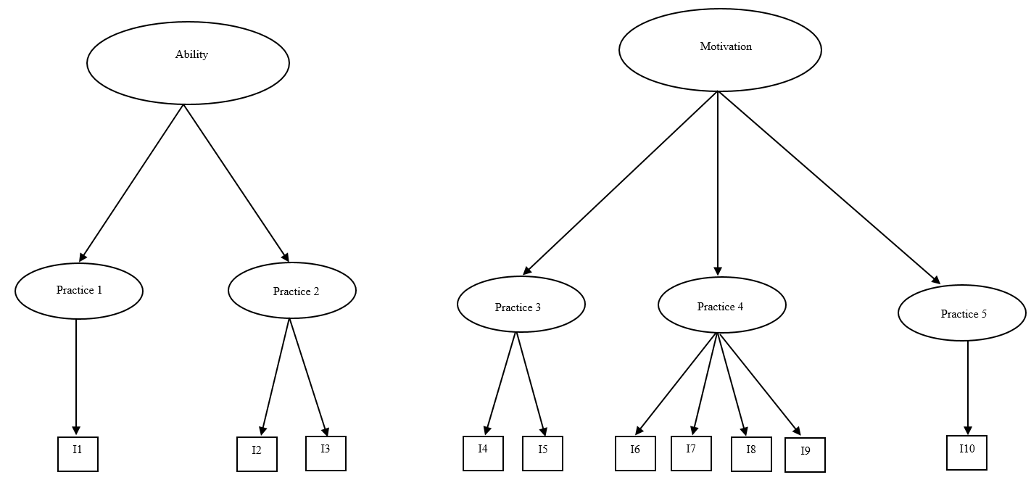

Slide 22
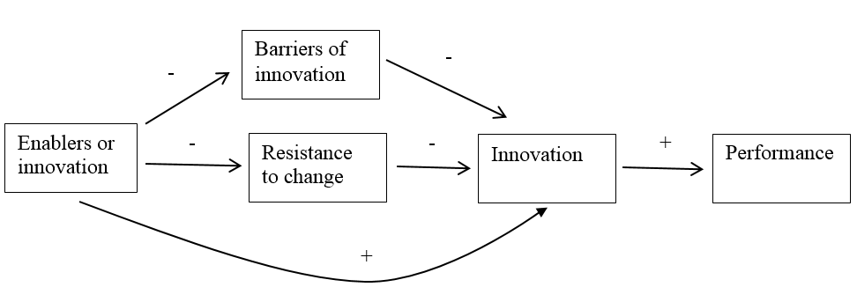

Slide 23
Ability to experiment: “Any organization that wishes to adapt to its changing environment needs a system for experimenting with new technologies and delivery models. Without the ability to develop experimental infrastructure, fundamentally new and different approaches rarely emerge… [p]ublic leaders must behave like venture capitalists by placing small bets based on a theory about the future and using those bets to guide subsequent action.
Ability to sunset outdated infrastructure: “If an experiment is successful, a new challenge is revealed—namely, phasing out the old product or service… Most government agencies do not experience this process— just look at the difficulty the US Postal Service is having in cutting back its delivery schedule. In fact, many agencies actually lack the ability to freely remove outdated technology and business models.”

Slide 24
Existence of feedback loops: “Once the experimental infrastructure is in place, it should be no surprise that strong feedback loops between the citizens and public servants are required to motivate investment into and adoption of the right innovations… Citizens can express dissatisfaction through votes, but these votes are rarely effective at critiquing the performance of specific programs. Unfortunately, without explicit feedback, it is difficult for managers running these programs to judge when to focus on improving service versus reducing cost.”
Existence of incentives for product or service improvement: “Though the profit motive does not exist in the public sector, motivation can still be created. For example, decreasing their budget difficulties through access to increased revenue and reduced costs will incentivize senior managers to innovate. Similarly, individual government employees can be motivated by the mission of the work or by recognition for doing it. The difficulty in public management is not creating motivation—it is ensuring that motivation is appropriately aligned with the goals of the organization.”

Slide 25
Existence of budget constraints for end users: “In any transaction, customer behavior is affected by budget constraints. Budgets force prioritization.. For breakthrough innovation to take hold, government leaders should ensure that budget constraints exist for end users in order to motivate the appropriate prioritization. In some situations, such as in the case of individually distributed services like postal delivery, those constraints should be placed on the customers themselves. In other situations, such as in the case of defense procurement, the constraint should be placed on the person responsible for acquisition.

Slide 26
Appendix 1: Alpha Variables for Summated Scales
alpha supervpoor dealperfor, item
Test scale = mean(unstandardized items)
Average interitem covariance: .4523046
Number of items in the scale: 2
Scale reliability coefficient: 0.6307
. alpha feedback supervfeed, item
Test scale = mean(unstandardized items)
Average interitem covariance: .7142514
Number of items in the scale: 2
Scale reliability coefficient: 0.8188
.
. alpha motivate inspire superinnov leadinnov, item
Test scale = mean(unstandardized items)
average
item-test item-rest interitem
Item | Obs Sign correlation correlation covariance alpha
-------------+-----------------------------------------------------------------
motivate | 21703 + 0.8668 0.7476 .4119854 0.6857
inspire | 21703 + 0.8716 0.7523 .4021364 0.6815
superinnov | 21703 + 0.6917 0.4403 .578169 0.8383
leadinnov | 21703 + 0.7466 0.5505 .5285263 0.7807
-------------+-----------------------------------------------------------------
Test scale | .4802043 0.8009
-------------------------------------------------------------------------------

