Slide 1
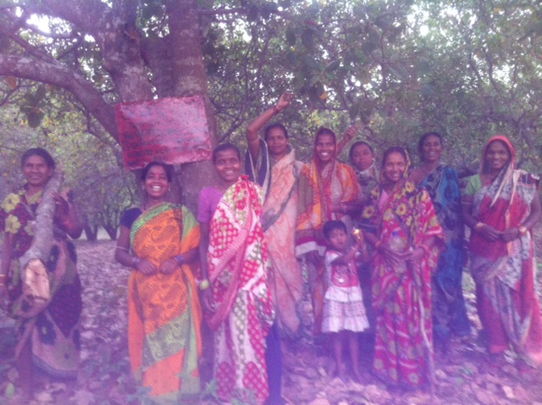
FOREST TENURE REFORM IN ODISHA
The Indian Forest Rights Act and Its Impact on the Livelihoods of Scheduled Tribes and Other Forest Dwellers in Odisha
Notes:
Explain Forest Tenure reform, Odisha, indian forest rights act, scheduled tribes and other forest dwellers

Slide 2
MAIN RESEARCH QUESTION
To what extent has state controlled forest tenure reform in Odisha been able to devolve decision making power and access rights to forest dependent communities?
Forest Tenure Reform: “who is allowed to use which resources, in what way, for how long and under what conditions, as well as who is entitled to transfer rights to others and how” (Larson et al, 2010)
Impact of devolution (most intense form of decentralization) (Ribot, 2001; Sundar, 2000)
Notes:
Explain devolution and why Odisha was chosen: Odisha has an interesting evolution in the management of forests, starting with transfers of large forest land areas from zamindars (ladowners) and princes to the government in the 1950s, followed by a unified state policy in 1972 for the classification and management of forests. These developments led to the formal involvement of communities under the 1985 Forest Village Rules, which spurred community forestry in many areas, and the national joint forest management (JFM) policy (Rout, 2001). Mirroring these historical developments, Odisha currently has three types of forest land tenure, including national parks and wildlife sanctuaries, reserved forests and protected forests, managed in 3 different ways: via the Joint Forest Management system (amended with FRA implementation), community forestry and private management by developers (such as paper mills) using the forest land (Singh, Singh and Sinha, 2003).
It has the second highest tribal population in India (62 groups in total, of which 13 are particularly vulnerable tribal groups – PVTGs) and the largest forest cover. In addition the state government of Odisha keeps consistent data records on FRA implementation, has both reserve and non-reserve forest areas, varied levels of development indicators from state to state and a range of intervention from both local and international non-state institutions.

Slide 3
Background
Global Experience:
Indonesia
Guatemala
Thailand
Indian Experience: Arrangement with maharajas, impact of the British,
“annexationists” who supported state monopoly over forest areas; the “populists” who supported that the customary rights and control formerly enjoyed by village communities should be retained; and the “pragmatists” who attempted to bridge the two perspectives by creating different “classes” of forests within the language of the act, including “state forests,” “village forests” and “private forests” (Gadgil and Guha, 1992: 123-43). “Village forests” for instance were meant to be demarcated for the use of forest dependent village communities, including the creation of a “council of men (one elected from each village) form a forest court to settle disputes arising out of the management of village forests” (Guha, 1996:92, as cited in Sundar, 2000:261). / Power of Forest and Revenue department / Clash with Wildlife lobby / Mass evictions.

Slide 4
Why is this relevant?
1) How new regulation in forest tenure reform can be better designed to meet community needs and how communities are accessing and implementing the “rights” they have received. What types of governance frameworks are being used? (Bose, 2011; Larson and Pulhin, 2012)
2) What communities’ actual livelihood benefits are when common property rights are allotted (Dahal et al, 2011)
3) What type of group composition in community forestry groups results in high levels of cooperation (Y.Sun et al. 2011).

Slide 5
Main Rights Provisions of the FRA
State Level Monitoring Committee
District Level Committee
Sub-divisional level committee
Gram Sabha
Forest Rights Committee

Slide 6
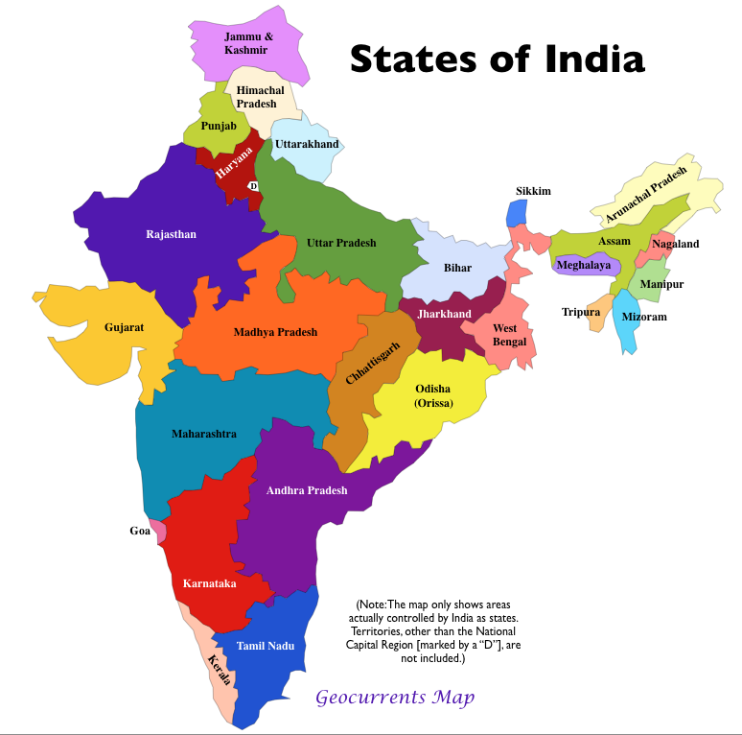
Why Odisha?
% of ST population: 22.8%
% of forest cover: 31.41%
“Success case” according to government records:

Slide 7
Main Argument
Devolution in the context of the Indian Forest Rights Act has worked selectively. This is largely due to non-transfer of rights to forest dependent communities and inert bureaucratic structures lacking in downward accountability towards self-governance systems at the village level.

Slide 8
Theoretical Approach
Notes:
Institutional Analysis within the framework/literature of public policy literature – addressing devolution and forest tenure reform
Human Rights Based Approach – often used by governments, NGOs and international organizations when trying to evaluate impact of such devolution related programs.

Slide 9
Methodology
Case study approach driven by the following sub-research questions: How are non-state institutions (such as NGOs, forums, campaign groups, federations and cooperatives) using the FRA to increase access to forest land and resources for forest dependent communities?
How are state institutions and existing governance frameworks responding to claims submissions made by forest dependent communities?
How are groups at the margin of the community, such as women and scheduled castes, being included in decision-making processes related to forest tenure reform?
How accessible and inclusive are the forest rights act governance structures (forest rights committees, sub-divisional level committees and district level committees) for forest dependent communities?
How are forest dependent communities able to exercise their forest right after receiving either individual or community tenure?

Slide 10
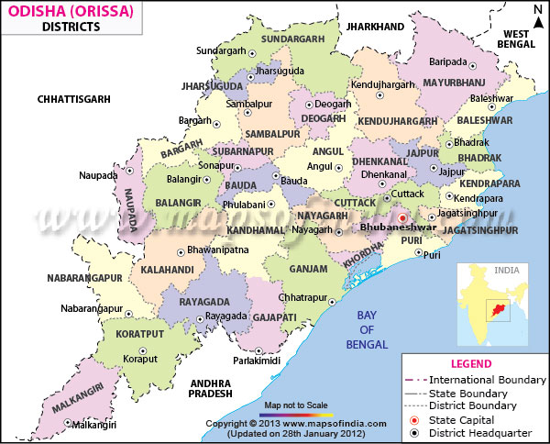
District Field Sites in Odisha
District criteria: ecological, socio-economic, government status of implementation reports, mining presence, sanctuary presence, % of ST and SC population
Village Criteria:
title holders versus claims applicants; village location; heterogeneous versus homogenous populations; proximity to sanctuary areas; proximity to mining areas.

Slide 11
INITIAL FINDINGS AND THEORETICAL IMPLICATIONS
Type of Stakeholder | Number of and type of Interview | Common results (all transcriptions analyzed through NVIVO 10) | Consequences for Policy Implementation and Evaluation (drawing from theory)
Government Officials | 19 individual interviews | Coordination issues between different departments Deadline for conferring titles Large, unsurveyed areas Capacity building of the Gram Sabha Other forest dweller category Convergence programming | Failure in downward accountabilty Failure in aims of devolution (Agarwal and Ribot)
Civil Society Members, Activists and Experts | 20 individual interviews | Key advantages include its emphasis on Gram Sabha consent in decision making processes, its prevention of large scale evictions (more indirectly) and the success of mass based movements to sensitize and mobilize communities to benefit from this act. Challenges largely remain due to power roles of significant actors, such as the forest department and clashes with other significant legislations such as Wildlife Protection Act, Forest Conservation Act and the 1927 Forest Act. Implementation challenges are apparent in the operationalization of the so called rights, such as selling and marketing of NTFPs. In addition, convergence programming has been difficult as it requires a large amount of physical and monetary resources. “Other Forest Dwellers” have largely been overlooked in the title distributions, causing community fragmentation among heterogeneous village populations. Much of the decisionmaking power continues to lie with the district administration and specifically the District Collector and the sub-divisional level committee. | Design principles for communities self-governing not present (Ostrom)

Slide 12
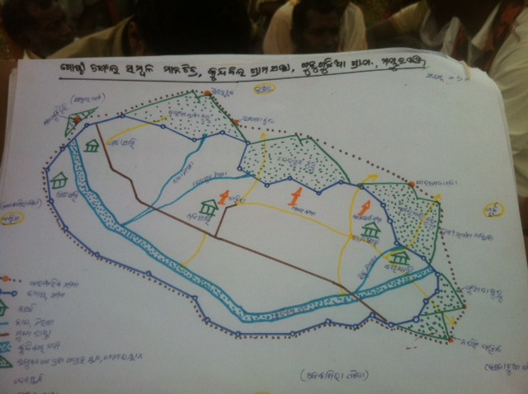
How a community sees its village

Slide 13
PUBLIC POLICY RECOMMENDATIONS
A review of legislations which conflict with the Forest Rights Act and how these clashes can be amended at both the central and state level.
Better monitoring and documentation of the Claims committee process, from the State level down to the Forest Rights Committee level.
A more sustained effort by the district level administration to include marginalized groups (not just scheduled tribes, but non-scheduled tribes and other forest dwellers) in consultations on clarifications to the Act, appeals processes and suggestions for possible amendments
Replication or adaptation of successful coordination processes between government departments in other districts and states.
Documentation of best practices by District Collectors across India and civil society actors for sensitization methods, the claims process and an understanding of long term capacity building post-rights recognition.

Slide 15
