Slide 1
UCD Sutherland
School of Law
Food Safety Regulation in China: Government Monopoly?
——A Theoretical Analysis
AN Yongkang
Yongkang.an@ucdconnect.ie

Slide 2
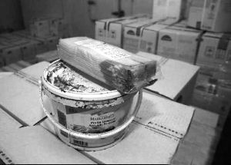
What’s the problem?
UCD Sutherland
School of Law
A tip of the iceberg: Guangqi Incident (2014.3·15)
“A Bite of China” [a popular documentary]
Who is responsible for the safety of what we eat everyday??
http://news.163.com/14/0317/03/9NGR6EUI00014Q4P.html
http://www.guancha.cn/Celebrity/2013_06_03_148916.shtml

Slide 3
Where is the rub?
UCD Sutherland
School of Law
Information-gathering (monitoring)
Lack of resources;
Local protectionism;
Inadequate inspection
…
Standard-setting
(norms)
Diversified Actors
Formal enforcement;
Light touch;
…
Behaviour-modification (enforcement)
Generality
Vagueness
Unreasonable
…

Slide 4
What is the status quo?
UCD Sutherland
School of Law
Information-gathering (monitoring)
Food authorities;
Certification bodies;
Whistleblowers;
Businesses;
Mass media;
Consumers;
General Public
Standard-setting
(norms)
Diversified Actors
Food authorities;
Certification bodies;
Peer pressure;
Community sanction
Behaviour-modification (enforcement)
The state;
FBOs’ organisations;
Standadisation bodies;
…

Slide 5
Where is the prospect?
UCD Sutherland
School of Law
Dysfunction of & facilitation by the state
Capacities of private bodies
Incentives for private regulation
Food safety regulation should not and cannot be monopolised by the government. Private regulation, in particular that by the food industry itself, is necessary and possible. BUT no one is omniscient nor omnipotent. The space is occupied by diversified actors.

Slide 6
UCD Sutherland
School of Law
Thank you!
AN Yongkang
Yongkang.an@ucdconnect.ie

